Slide 2
Getting Involved
NCURA and the UW RED Program
Sandy Fowler, College of Agricultural and Life Sciences
Kristin Harmon, Office of the Vice Chancellor for Research
Melanie Hebl, Sustainability Research Hub
Stephanie Wilbrand, PhD, School of Medicine and Public Health

Slide 3
Why might you want to get more involved?
Sense of Belonging
Contribution to your Profession and Peers
Enhancing Communication Skills
Increased Confidence
Networking Opportunities
Career Advancement
  greater visibility and opportunities to demonstrate leadership
Personal Brand Development
  Establishing yourself as an expert in the field
  Increased recognition and credibility

Slide 4
Introduction to NCURA
National Council of Research Administrators

Slide 5


Slide 6
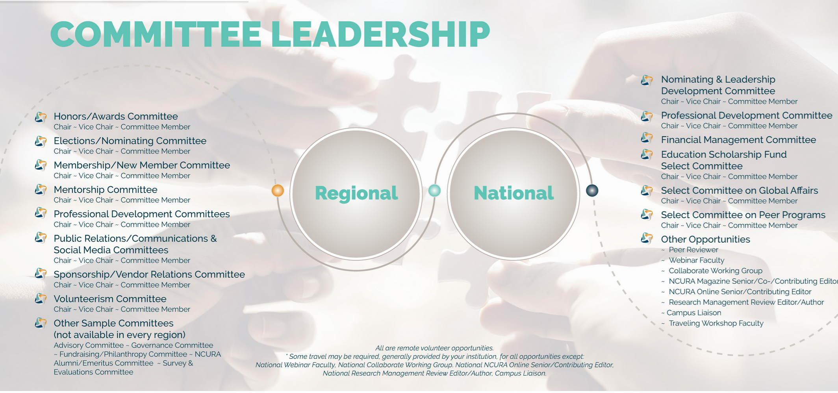

Slide 7
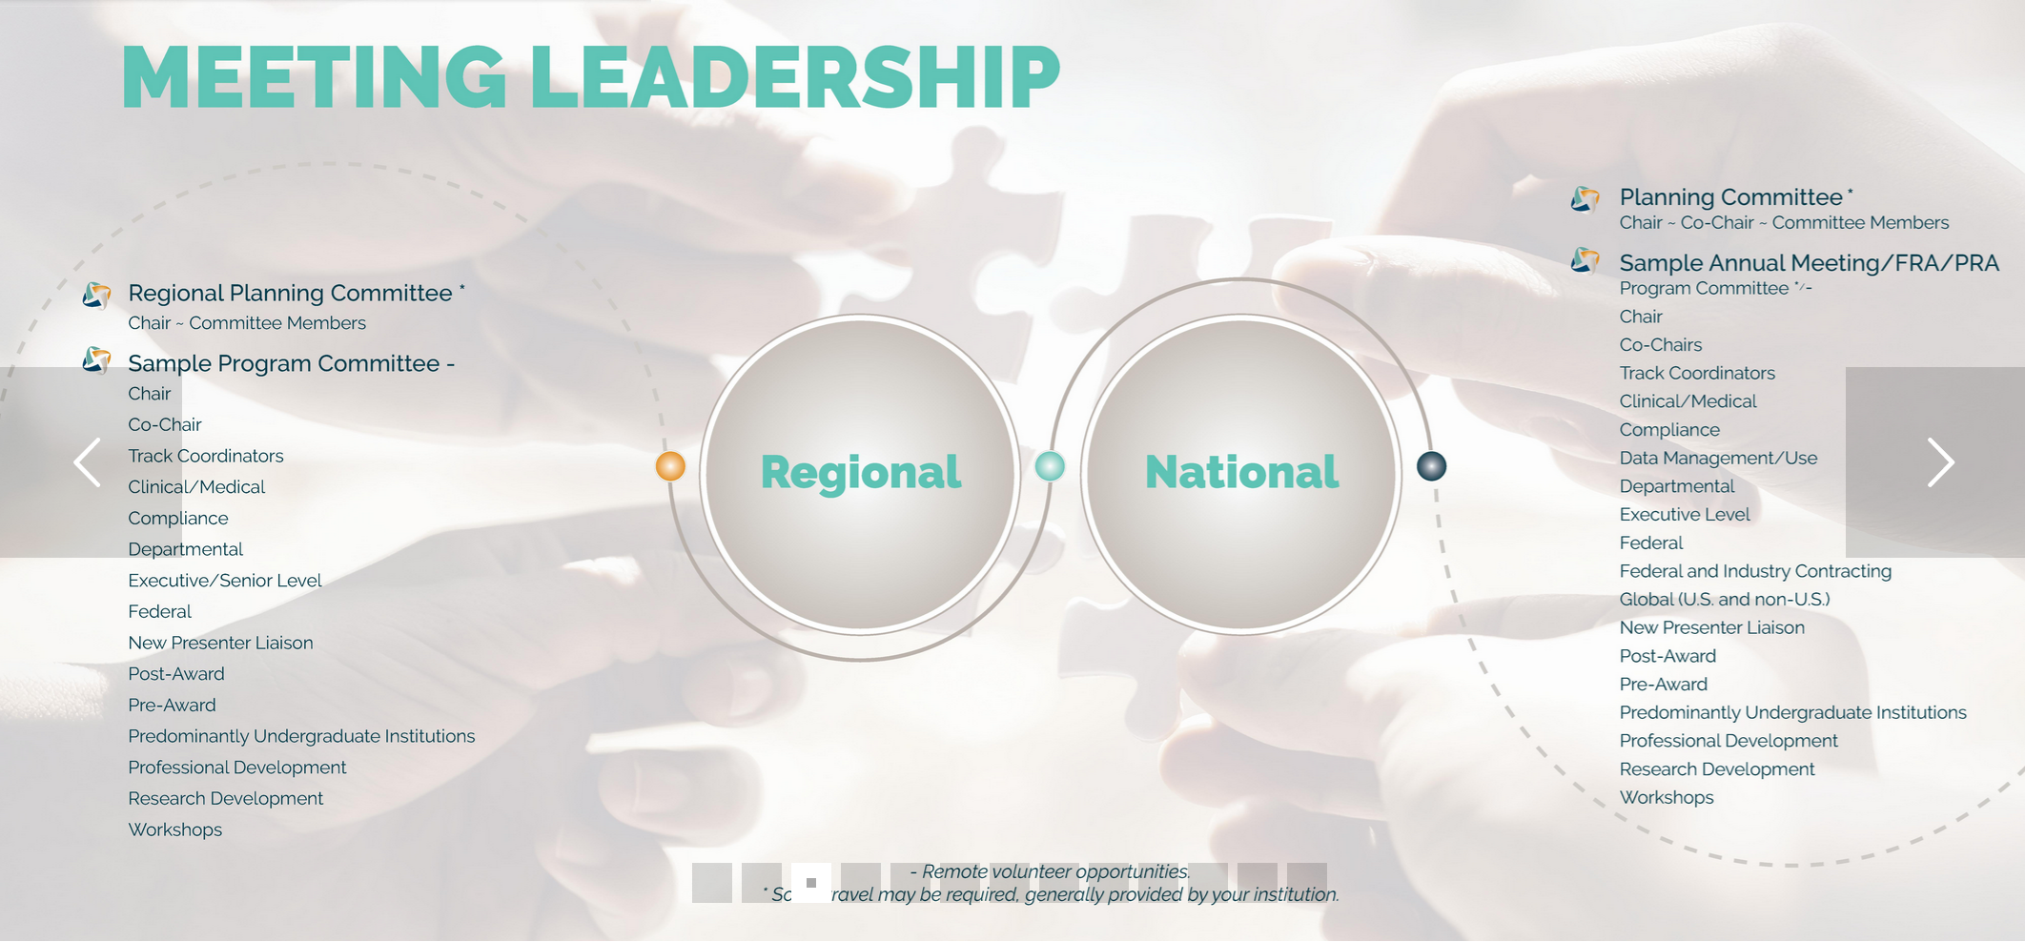

Slide 8
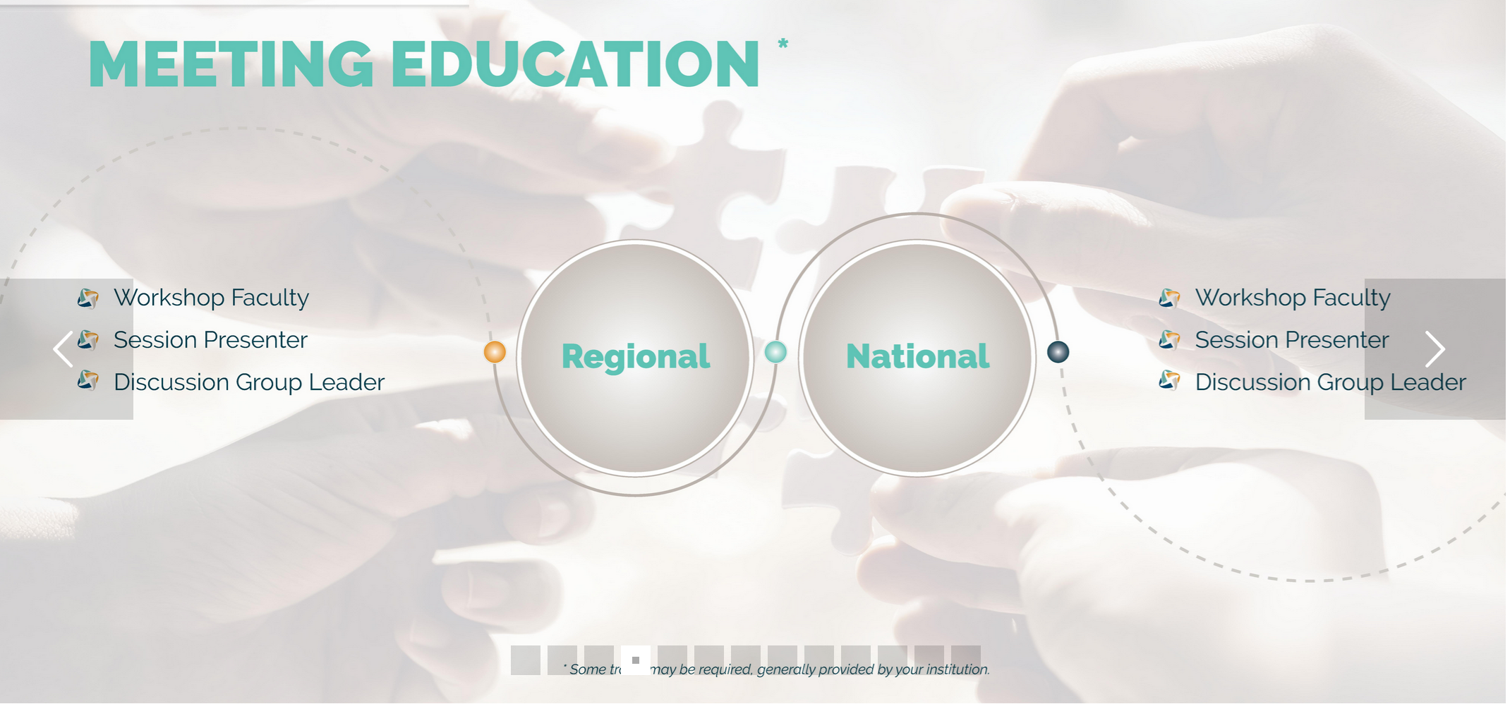

Slide 9
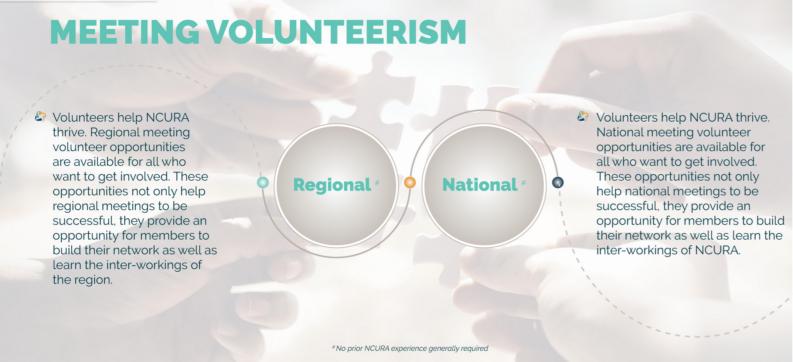

Slide 10
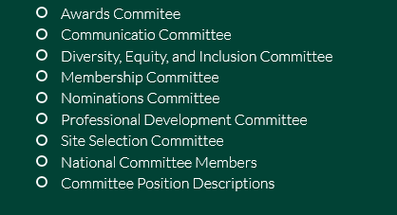
Region IV Committees

Slide 11
Introduction to RED
Research – Education – Development

Slide 12
RED Program
Symposium Planning Committee (3- year term)
  Call for members
Symposium Speakers
  Call for volunteers
RED Mentoring Program (1-year commitment)
  Call for members
  Mentee or Mentor
RED Course Subject Matter Expert Groups
  Reach out to express interest
  red@rsp.wisc.edu
RED Course Facilitators
  Reach out to express interest
  red@rsp.wisc.edu

Slide 13
Questions and Discussion
Getting Involved
NCURA and the UW RED Program

